Slide 1


GoogleTM
Vikramaditya Reddy.J.
VNR VJIET

Slide 2
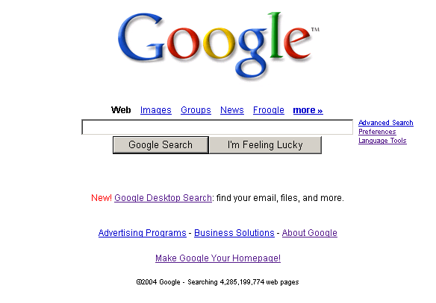
http://www.google.com

Slide 3
What is GoogleTM?
A powerful full-text search engine that indexes the title description and page content of over 4.28 billion websites (out of over 10 billion), making it the largest search engine on the web
A tool for librarians
A play on the word googol
A publicly owned company (as of August 18, 2004) whose motto is “Don’t be evil”
Pop-up free!
A site that has launched a vocabulary all it’s own

Slide 4
What isn’t GoogleTM?
A collection of all the sites on the Internet
A library, or replacement for a library
A web portal
An Internet filter (although it has a content filter, SafeSearch, like all other filters, isn’t perfect)
A directory (although it contains a directory)
An archive of all the websites that ever there were

Slide 5

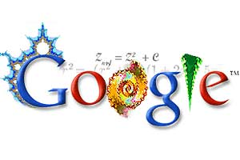
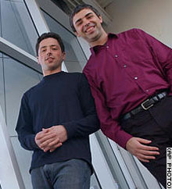
Co-Founders
Larry Page (left)
BS in engineering (focus on computer engineering
MBA at University of Michigan(on leave from Ph.D.program atStanford)
Sergey Brin (right)
native of Moscow, BS in mathematics and computer science from the University of Maryland
Master’s in CS at Stanford University, (on leave from the Ph.D. program)
Larry Page:
President of Products
Sergey Brin:
President of Technology

Slide 6

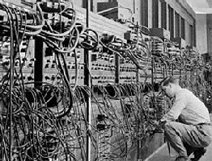
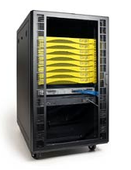
How We Got Here....
For the last 5 years, Google has been the undisputed leader in online search technology.
Before Google; Altavista, FAST, and Inktomi had the largest databases; but suffered from poorer search algorithms.
Google's profit is partially ad driven, but sponsors do not garner higher ratings in searches.

Slide 7

Searching and Beyond...
  Localization
  Language options
  Toolbar
  Blogger
  Translation
  Calculator
  Stock Quotes
  Phonebook
  Newsgroups
  Programming tools
  Intra-network searches
  Print searching
  Desktop search
  Mobile Access
  News
  Spell Checker
  Pricing

Slide 8
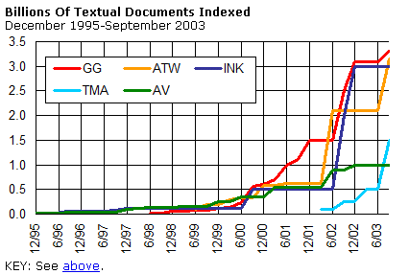
Search Engine Supremacy
http://searchenginewatch.com/reports/article.php/2156481

Slide 9
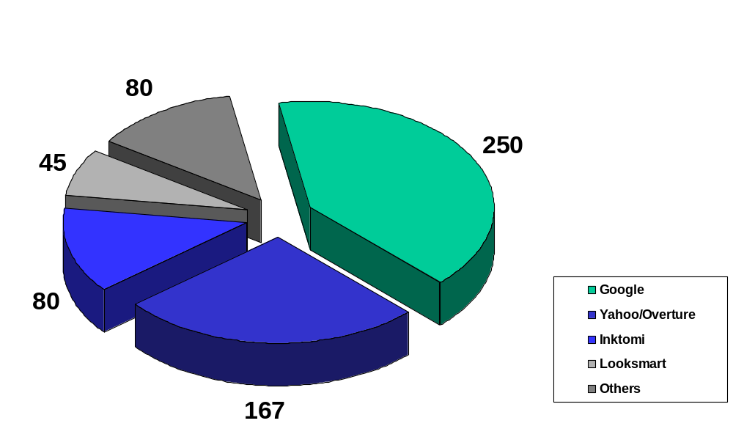
Searches Per Day in Millions
http://searchenginewatch.com/reports/article.php/2156461

Slide 10

So How Does Google Work?
Crawls and indexes web pages et al.
Stores copies of web pages and graphics on their caching servers
Presents users with simple front end to query the database of cached pages
Returns search results in a ordered fashion based upon relevancy

Slide 11
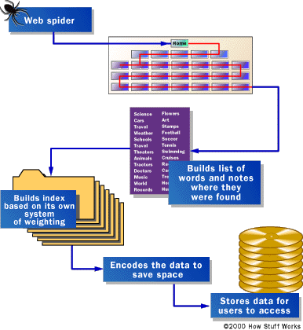
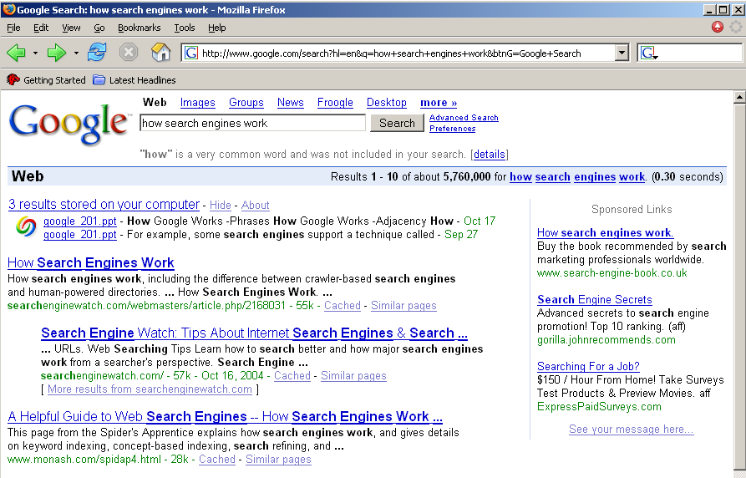
Anatomy of a Search
Server Side Client Side

Slide 12
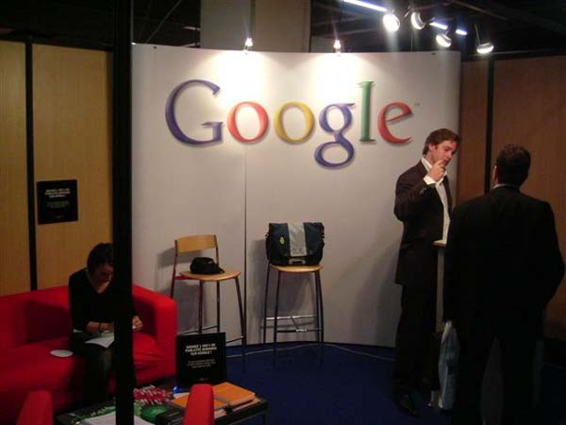
What Can Google Search?
Adobe Portable Document Format (pdf)
Adobe PostScript (ps)
Lotus 1-2-3 (wk1, wk2, wk3, wk4, wk5, wki, wks, wku)
Lotus WordPro (lwp)
MacWrite (mw)
Microsoft Excel (xls)
Microsoft PowerPoint (ppt)
Microsoft Word (doc)
Microsoft Works (wks, wps, wdb)
Microsoft Write (wri)
Rich Text Format (rtf)
Shockwave Flash (swf)
Text (ans, txt)

Slide 13
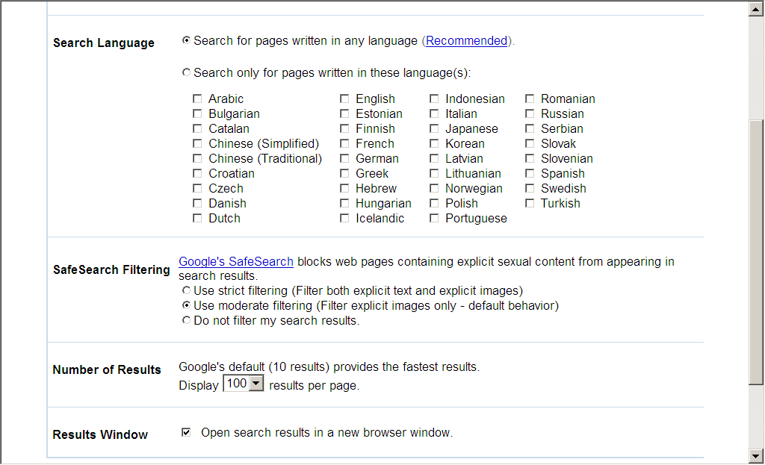
Google Preferences

Slide 14
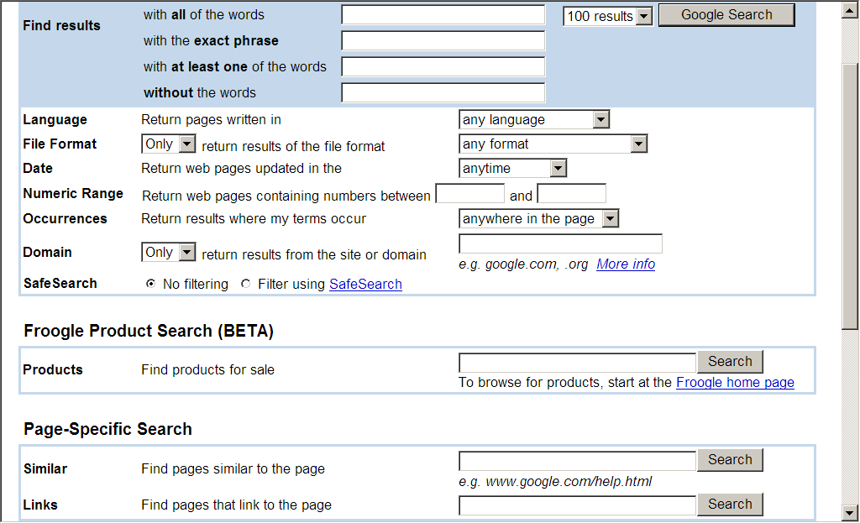
Google Advanced

Slide 15

So What Determines Page Relevance and Rating?
Exact Phrase: are your keywords found as an exact phrase in any pages?
Adjacency: how close are your keywords to each other?
Weighting: how many times do the keywords appear in the page?
PageRank/Links: How many links point to the page? How many links are actually in the page?
Equation: (Exact Phrase Hit)+(AdjacencyFactor)+(Weight) * (PageRank/Links)

Slide 16

Enough BS, How Do I Get Results?
Pick your keywords carefully & be specific
Do NOT exceed 10 keywords
Use Boolean modifiers
Use advanced operators
Google ignores some words*:
a, about, an, and, are, as, at, be, by, from, how, i, in, is, it, of,
on, or, that, the, this, to, we, what, when, where, which, with

Slide 17
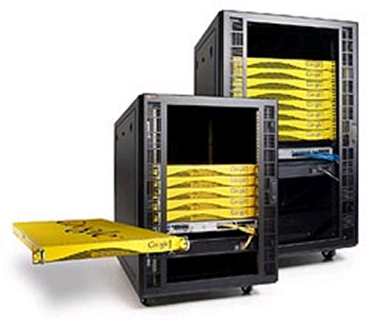
Advanced Operators
cache:
define:
info:
intext:
intitle:
inurl:
link:
related:
stocks:
filetype:
numrange 1973..2005
source:
phonebook:
http://www.googleguide.com/advanced_operators.html

Slide 18
General Tips
GoogleTM defaults to the “AND” Boolean search, which means when you type in more than one keyword, it looks for all the words on one page (you can also use Advanced Searching for Boolean searches)
Use “+” and “-” signs for AND and NOT
Use “~” to include synonyms
Wildcards for characters or character strings don’t work, but you can use an asterisk in place of a word in a phrase
To get the most commonly viewed page for your search terms, click “I’m Feeling Lucky”

Slide 19

Beyond “I’m Feeling Lucky”
Search for phrases by putting “quotes around keywords” in a series
Ordering of keywords may be important!
Repetition of keywords may change results
Limit by language or filetype with “Preferences.”
Find keywords in title, URL or text
Limit to a specific GoogleTM database

Slide 20
Basics : Using Syntaxes
Syntaxes tell GoogleTM to limit or search a specific database
“stocks:” brings up comparitive pages of stock information
“phonebook:” limits to GoogleTM business and residential phonebook databases
“site:DOMAIN” limits to a type of domain. Reminder: there are now 11 types (not counting country domains): .com, edu, .gov, .firm, .info, .mil, .net, .nom, .org, .store, .web
“site:URL” limits to pages within the specified URL

Slide 21

GoogleTM Glossary
Go to: http://www.googleguide.com/glossary.html
GoogleTM automatically spell-checks – look for the “Did you mean” feature
Hacks: add “define” or “what is” or “what are” to your keyword to get a definition

Slide 22
GoogleTM Calculator
Go to: http://www.google.com/help/calculator.html
Basic math: add, subtract, multiply, divide
Advanced functions: algebra, trigonometry, square roots
Unit conversions from fahrenheit to celsius, miles to kilometers, and more

Slide 23

GoogleTM Phonebook
Go to: http://phonebook.google.com
Use to locate phone numbers or addresses for people or businesses
Hacks: “phonebook:”
Type in a name and location to find a listing
Type in a phone number for reverse lookup
To remove your own name, go to: http://www.google.com/help/pbremoval.html

Slide 24

GoogleTM News
Go to: http://news.google.com/nwshp
GoogleTM News clusters stories, making it easy to follow a thread
Hack: Use intitle: to locate keyword in article headline; use insite to find news from a particular source (useful in searching archives)
Hack: copyright disclaimers to locate articles in a specific publication
Sign up for email delivery to follow news stories at: http://www.google.com/alerts
Look for “news” links for current event searches

Slide 25

GoogleTM University
Go to: http://www.google.com/options/universities.html
Higher education organizations get free site search
Search within websites for course catalogs, events, financial aid, etc.

Slide 26


Government
Go to: http://www.google.com/unclesam
Limits search to US government websites
Defaults to pages ending in .gov and .mil

Slide 27




GoogleTM OS
Go to http://www.google.com/options/specialsearches.html
Search for pages and products related to specific systems
Mac
Microsoft
BSD
Linux

Slide 28

GoogleTM Images
Go to http://images.google.com
Search over 880 million images to locate pictures and graphics
Use advanced searching to limit file type and size
Use alternative words if multiple meanings may cause a problem

Slide 29
GoogleTM Groups
Go to: http://groups.google.com/
Contains over 845 million searchable Usenet archives from 1981 to present, arranged in hierarchies
Use for commentaries after events, directions or solutions to FAQs, and pre-web events that might have been discussed in bulletin board/usenet forums
Beta version has a members feature, incorporates member created groups and usenet groups
Search within specific groups and with SafeSearch enabled

Slide 30

FroogleTM
Go to: http://www.google.com/froogle
Use for smart shopping search for an item and an image of the item appears alongside URL
Limit to a price range, view in list or grid format, sort results by store, and search by category

Slide 31
GoogleTM Directory
Go to: http://directory.google.com/
Contains a smaller collection of over 1.5 millions URLs, selected by GoogleTM editors (and users!) and arranged into categories
Use when trying to narrow a search in a broad category
Most popular terms in subcategories are in boldface
Related categories allow cross-referencing
Pages are arranged by rank, evaluated in their usefulness by other web users
Allows you to search within a category
Hacks: intitle: and inurl:

Slide 32


GoogleTM Tools
GoogleTM Toolbar
Go to: http://toolbar.google.com/
Works with MS IE – Search without visiting site
Blogger
Go to: http://www.blogger.com
Weblog tool for online journaling, RSS feed and more
http://hiplibrariansbookblog.blogspot.com/

Slide 33


More GoogleTM Tools
Translator
Go to: http://www.google.com/language_tools
Use as a translation tool
Picasa
Go to: http://www.picasa.com/picasa/
Picasa works with the digital photo files on your PC to create a better, more organized viewing and editing experience

Slide 34
GoogleTM Beta
NEW!
GoogleTM Deskbar
Go to: http://desktop.google.com/
Download and install a search engine to locate files on your computer, including cached webpages, chats, emails, etc.
GoogleTM SMS
Go to: http://www.google.com/sms/
Short Message Service allows you to get text message answers to questions using your cell phone and going to www.466453.com
Useful for phone number lookup, product price checks, etc.

Slide 35
More GoogleTM Beta
NEW!
GoogleTM Personalized
Go to: http://labs.google.com/personalized
Create a username and profile, indicating your personal interests
Skew results to more or less personal influences
Rate results
GoogleTM Local
Go to: http://local.google.com/
Find local businesses and services

Slide 36
Even More GoogleTM Beta
NEW!
GoogleTM Sets
Go to: http://labs.google.com/sets
Put in a few keywords and GoogleTM will come up with other terms that fit the set. Useful in finding items by category such as car manufacturers, albums by a band, etc.
Useful for finding read-a-likes!
GoogleTM Catalogs
Go to: http://catalogs.google.com/
Scanned catalogs give new meaning to online shopping
Notes:
Example: Redwall, Mossflower, Long Patrol

Slide 37
Still More GoogleTM Beta
NEW!
GoogleTM Flavored
Go to: http://www.google.com/services/siteflavored.html
Create a Google Search Box on your site that does searches for information related to your site content
GoogleTM Groups 2
Go to: http://groups-beta.google.com
Registration required
Create and join searchable discussion groups, forums and mailing lists
Bookmark topics of interest to follow discussion threads with ease

Slide 38
Yet More GoogleTM Beta
NEW!
GoogleTM Compute
Go to: http://toolbar.google.com/dc/offerdc.html
Download a program that allows your computer to share resources to assist with research
FroogleTM Wireless
Go to: http://labs.google.com/froolewml.html
Use your smart phone to do product research on the run
Point your phone browser to http://wml.froogle.com to test
GoogleTM Webquotes
Delivers feedback of statements about your search

Slide 39
Fun with GoogleTM
Fake Languages
Go to http://www.google.com/language_tools?hl=en
Scroll down to “Language Tools” and set Google to “Bork, Bork, Bork,” “Elmer Fudd” or “Klingon”
GoogleTM Special Logos
Go to: http://www.google.com/holidaylogos.html
Online museum of past logos for special occasions
PigeonRanking
Go to: http://www.google.com/technology/pigeonrank.html
Notes:
Google Doodle: “sequential story” within logo, May 2000 http://www.google.com/doodle.html

Slide 40
